Slide 1
File Handling &
Intro to Oops

Slide 2
File Handling
File handling allows interaction with external files.
Why is it important?
Storing sensor data (e.g., temperature, pressure, speed).
Writing daily production reports.

Slide 3
File Handling Modes
"r": Read Only
"w": Write (Overwrite)
"a": Append (adds to the file)
"r+": Read & Write

Slide 4
File Handling Methods
read(): Reads the entire file.
readlines(): Reads line by line into a list.
readline(): Reads one line at a time, useful for large files.

Slide 5
Opening and Closing Files
Demonstrate opening a file for writing and closing it.
Example code snippet:
file = open("log.txt", "w") file.write("Machine Started. This is our 1st experiment!") file.close(
file = open("log.txt", "w") file.write("Machine Started. This is our 1st experiment!") file.close()

Slide 6
Reading from a File
Show how to open a file for reading and print its content.
Example code snippet:
file = open("log.txt", "r") content = file.read() print(content) file.close()

Slide 7
Writing and Appending to Files
Writing to a new file and appending to an existing file.
Example code snippet:
file = open("machine_status.txt", "w")
file.write("Machine A: Running\n")
file.close()
file = open("machine_status.txt", "a")
file.write("Machine C: Faulty\n")
file.close()

Slide 8
Use Cases of File Handling
Logging Machine Data:
Example of writing machine statuses to a log file.
Reading Sensor Data:
Example of reading sensor data from a CSV file.

Slide 9
Introduction to Exception Handling
Why use try-except?
Handle errors like file not found, file locked, or permission denied.
Prevent program crashes by handling exceptions gracefully.

Slide 10
Exception Handling Example
Example of handling division by zero: try: a = 4
b = 0
c = a / b
except Exception as e:
print(f"Exception: {e}")

Slide 11
Best Practices in File Handling
Validate file existence before reading.
Use try-except to handle file-related errors.
Example of checking file existence:
import os filename = "machine_status.txt" status = os.path.exists(filename) print(f"Status of file: {filename}: {status}")

Slide 12
Introduction to OOP
OOP organizes software design around objects.
Key Concepts:
Class: Blueprint for creating objects.
Object: Instance of a class.
Attribute: Data associated with an object.
Method: Functions inside a class.

Slide 13
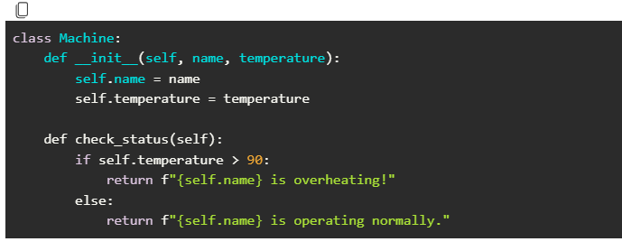
Basic class example

Slide 14
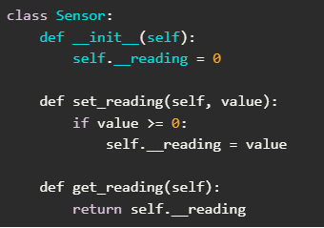
Encapsulation in OOP
Encapsulation hides internal object details.
Example of encapsulation using private attributes:

Slide 15
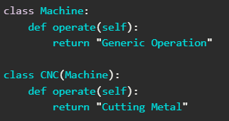
Inheritance in OOP
Inheritance allows creating specialized classes from a base class.
Example of inheritance:

